Slide 1
Maths Mini Project
Submitted by -
Hariom Vyas
Pushpendra Vishwakarma

Slide 2
Circuit Problem Analysis

Slide 3
How we solve circuits ?
Apply Fundamental Laws ( Ohm's Law and Kirchhoff's Laws (KVL & KCL) )
Nodal Voltage Method
Mesh Analysis

Slide 4
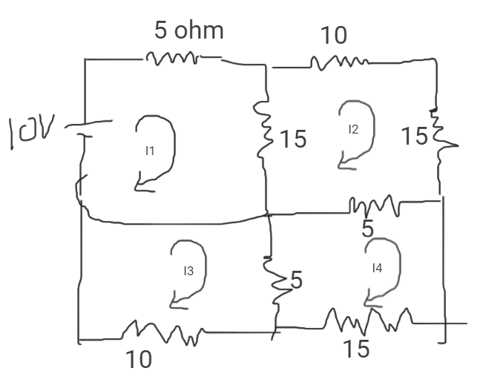
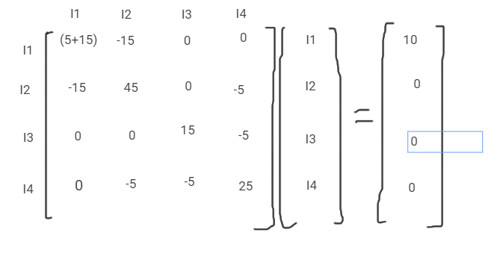
Approach to the problem ( Circuit - 1)
AX = B

Slide 5
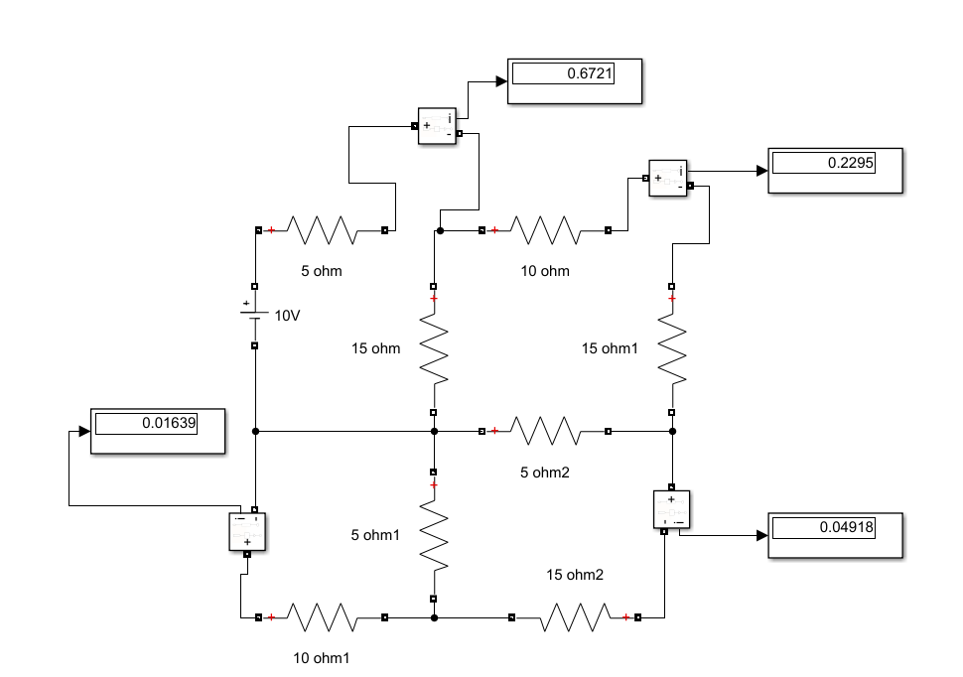

inv(A)*B or A\B

Slide 6
How we Mathematically compute { inv(A)*B } ??
Different Methods to Solve System of Simultaneous Linear Equations
Direct Method
a. Gauss Elimination
B. Gauss Jordan
C. LU Decomposition
Indirect Methods
A. Jacobi
B. Gauss Seidel

Slide 7
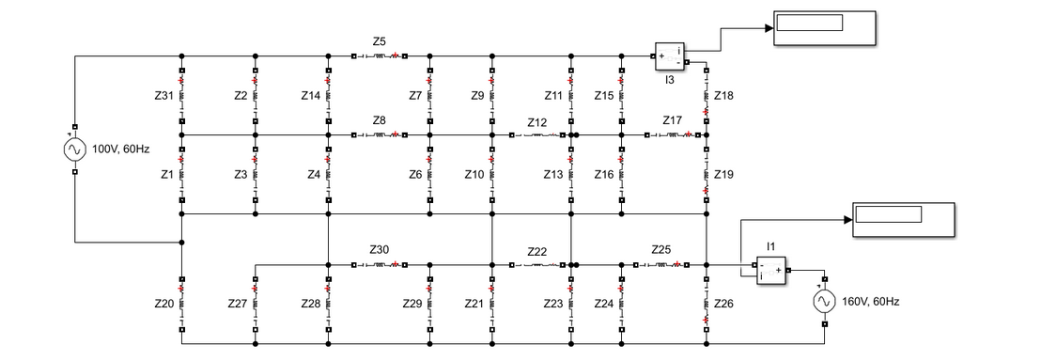
Problem 1

Slide 8
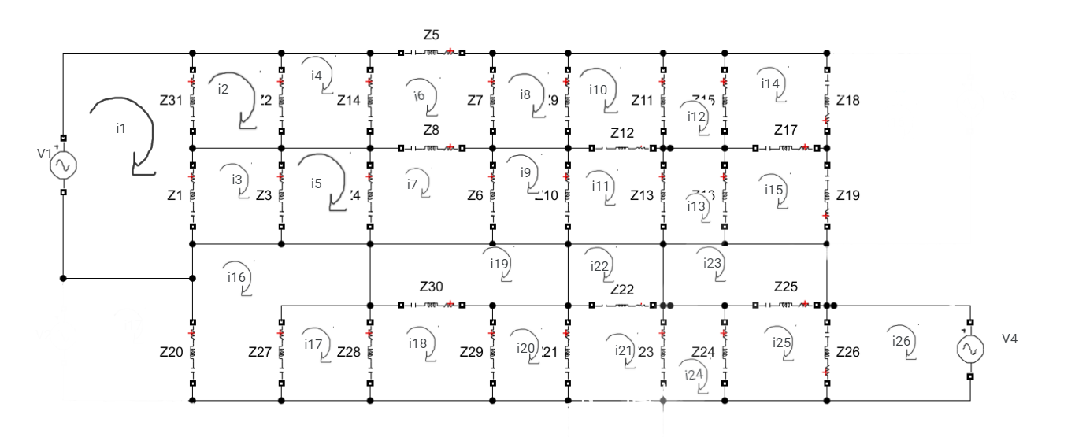

Slide 9
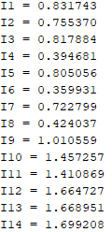
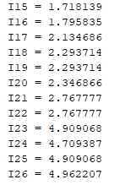
Values for Problem 1
AX = B
A = [ … ] ( Size 26 x 26 )
B = [ … ] Size ( 26 x 1 ),
But Can we trust the solution directly, how can we be sure that our current values can be trusted ?
For that we can use Conditioning, using Norms

Slide 10
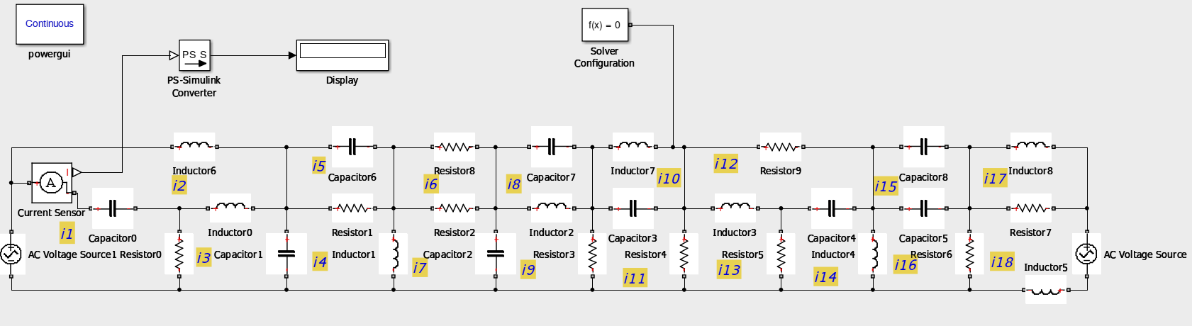
Problem 2

Slide 11
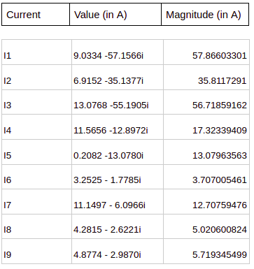
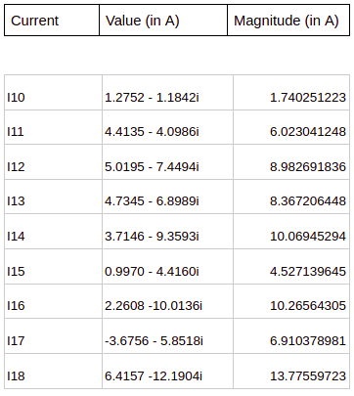
Values for Problem 2

Slide 12
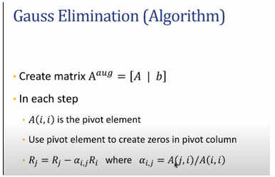

Gauss Elimination
Direct Methods
Note - Determinant of A should not be zero
Some Issues with Gauss Elimination Method
Division by Zero
This can happen if one of the diagonal elements become zero, in intermediate stage while on which the division was going on, so it will generate Division by Zero Error
Round off Errors
Result into, below kind of matrix

Slide 13
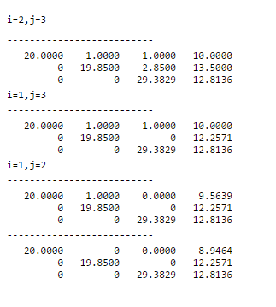
2. Gauss Jordan
Direct Methods
Similar to Gauss Elimination, but here we try to make non diagonal elements to be zero.

Slide 14
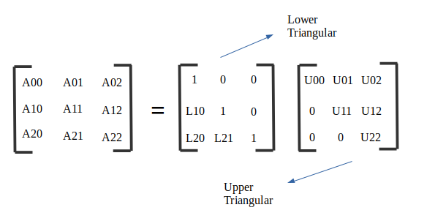
3. LU Decomposition
Direct Methods
For a non-singular matrix A, we write the matrix [A] in the form of multiplication of two matrices [L] ( Lower Triangular Matrix) and [U] ( Upper Triangular Matrix).
Thus, [A] = [L][U].
There are two methods to find the solution
By multiplying inverse of both [L] and [U].
By Forward and Backward Substitution

Slide 15
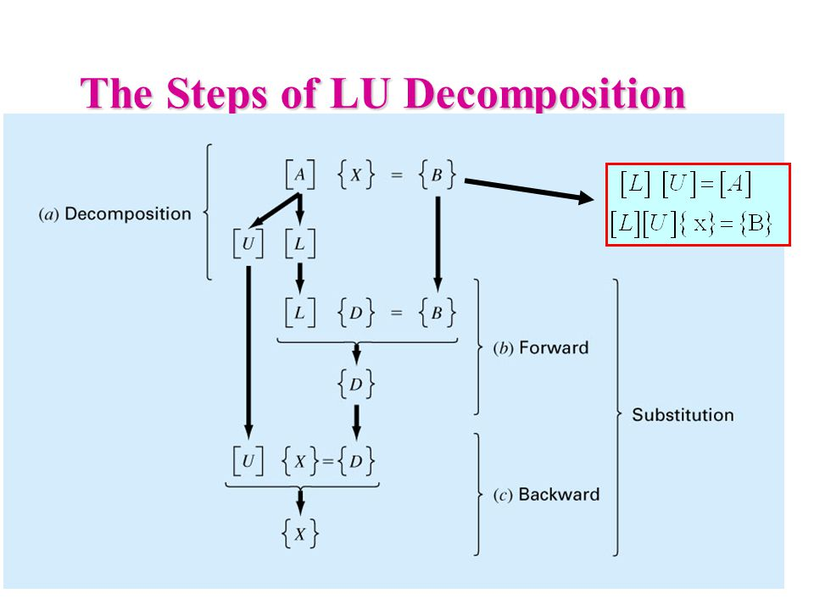
Forward and Backward Substitution
Direct Methods

Slide 16
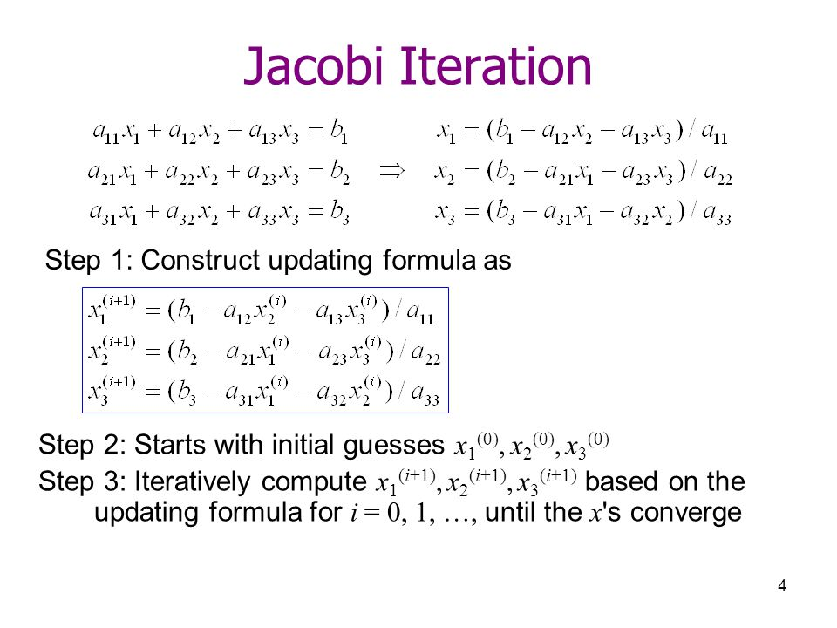
Jacobi
Indirect Methods
Given a linear equation, we take the initial value of all variables to be 0 and update the values after one iteration is completed.
There are a few limitations of this method
If there is a large difference between values ( i.e. if one value is 20 and other is 1000) then the iterations might not converge.
Time consuming as we take initial values as 0 and we get new values after the loop ends one iteration.
Not suitable for large systems.

Slide 17
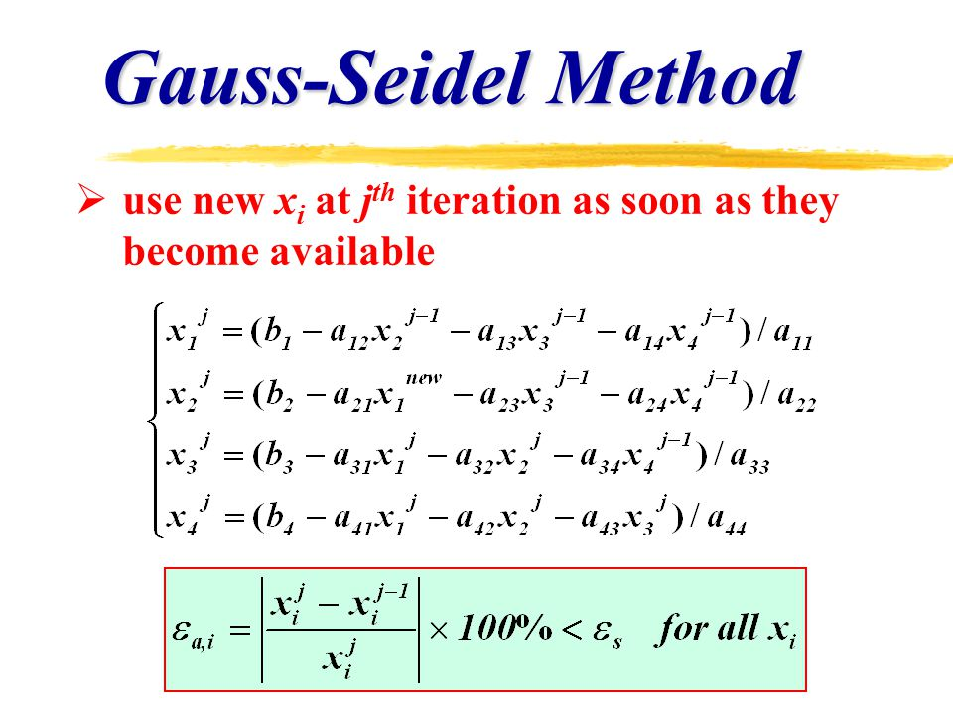
2. Gauss Seidel
Indirect Methods
The only difference between Gauss Seidel and Jacobi is that we use the new value of X_{i} as soon as it is available. ( i.e. After the first iteration X₁, we use that value in X₂, X₂, etc.)
It is faster than Jacobi method.
It is not suitable for larger systems as the values require large number of iterations to reach convergence.
Requires less memory than Jacobi method.

Slide 18
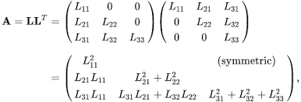
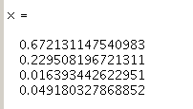
Cholesky Method
Direct Methods
For this method, matrix should be positive definite.
Also, diagonal values should be real.
So, we use the resistive network for this problem.
We write matrix [A] in the form of two matrices [A] = [L][L’].
Solving the circuit - 1 ( of resistive networks) we get the following values of current.

Slide 19



Adequacy of System of Linear Equations
Why do we need this ? For small change in input, there can be large variations in output, suppose if there is small error, then it is obvious that output should not much vary according to input. So, that’s why Adequacy is important before computing solutions
But How do we know whether a matrix is Well Conditioned or Ill Conditioned ?
Norms of a Matrix ( 1-Norms )
Conditioning Number
We can use `cond(A)` in MATLAB for directly Calculating the condition number, MATLAB Calculates this, by using 2-Norms

Slide 20
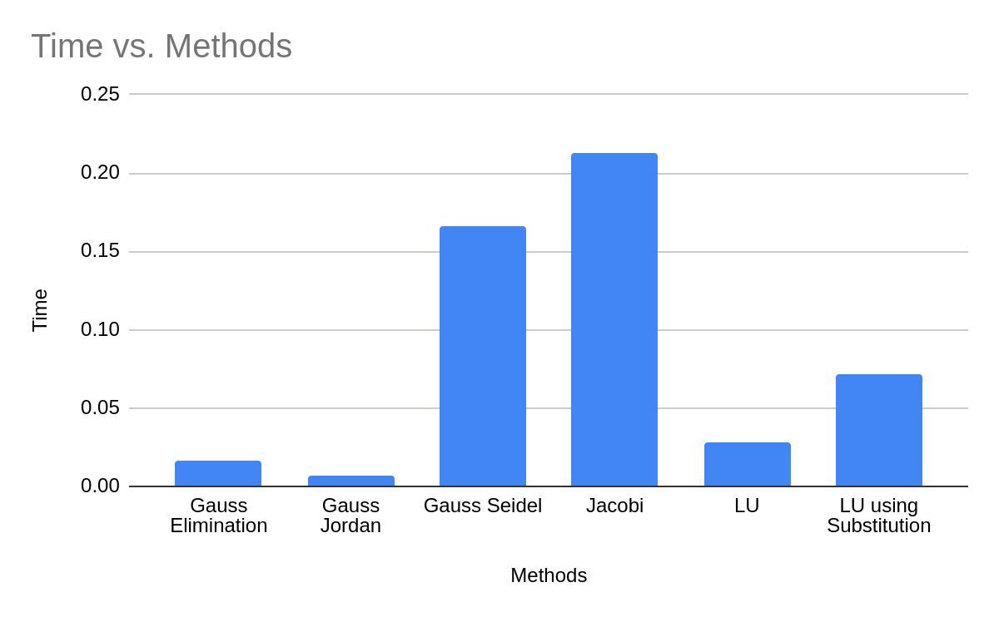
Comparison

Slide 21
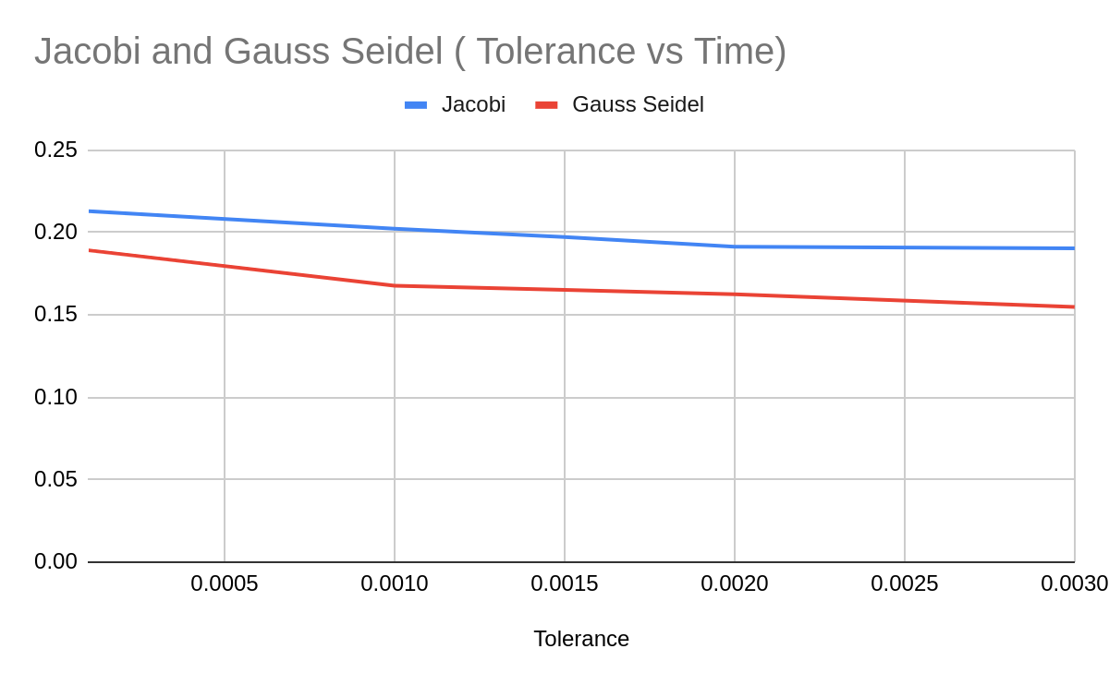
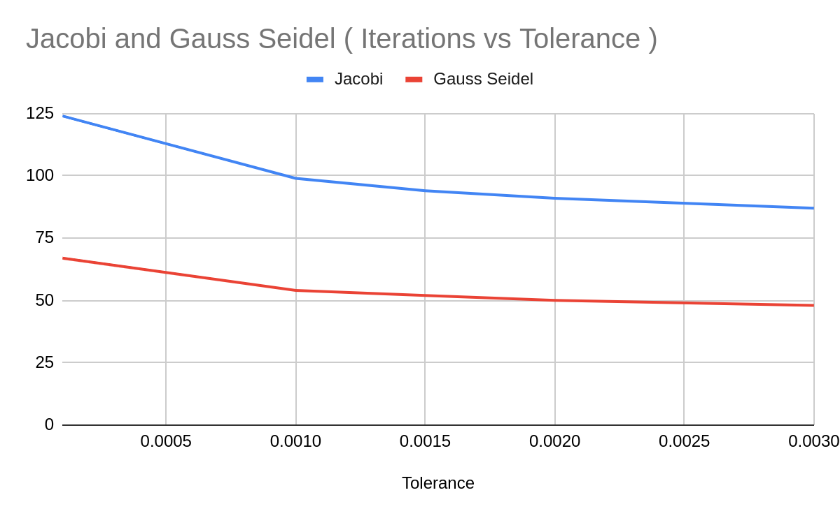
Comparison of Iteration and Time

Slide 22
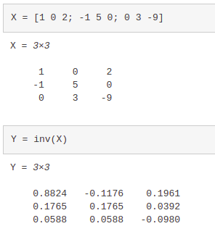
How matlab solves these problems ?
We use a inbuilt matlab function inv to find the inverse of a matrix.
inv performs an LU decomposition of the input matrix (or an LDL decomposition if the input matrix is Hermitian).
It then uses the result to form a linear system whose solution is the matrix inverse inv(X).

Slide 23
References
https://sites.math.washington.edu/~king/coursedir/m308a01/Projects/m308a01-pdf/taing.pdf
https://www.intmath.com/matrices-determinants/6-matrices-linear-equations.php
http://www.its.caltech.edu/~jpelab/phys1cp/AC%20Circuits%20and%20Complex%20Impedances.pdf

